Slide 1
Introduction to
Software Testing
2016 Axxes Traineeship
Gert Demol
Notes:
Hoe in testing beland? Cronos
Manueel testen kan iedereen -> test automation is the way to go
Veel testers zijn niet technisch

Slide 2
Agenda
Short quiz
Testing fundamentals
Behavior Driven Development (BDD)
Page Object Pattern
Selenium API
Selenium Excercice (Java + .NET setup)
We’ve only scratched the surface

Slide 3
Tester lingo quiz
Alpha and beta testing
Regression testing
White box and black box testing
Exploratory testing
Smoke test

Slide 4

How Google Tests Software
Notes:
3 profielen : software engineer, software engineer in test, test engineer -> combinatie high level maar ook heel diep kunnen gaan. .NET, Java 13 in een dozijn
Productie big bang bij veel bedrijven -> paniek. Google, NetFlix, Spotify: canary releases, risico beperken

Slide 5
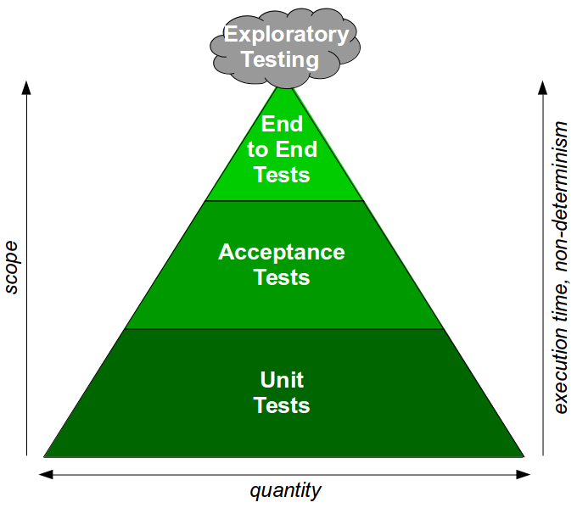
Testing Pyramid

Slide 6
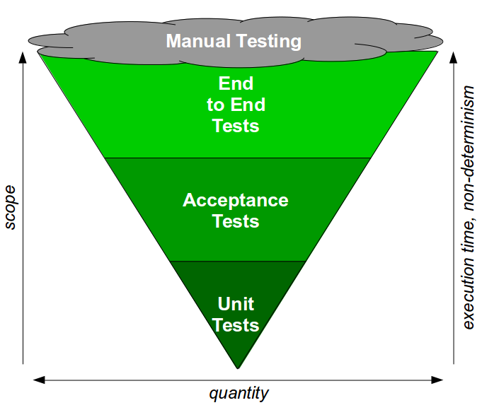
Testing Pyramid anti-pattern

Slide 7
Exhaustive Testing Impossible
Impossible to test every possible user interaction
Risk Based Testing
Which scenario is the most likely to occur?
In which section of the application do most of the bugs occur?
Interaction with external dependencies

Slide 8
Behaviour driven development
Better known as BDD (or ATDD)
Agile software development technique
Extends TDD by writing
Testable requirements
In natural language that non-technical people can understand
Use of ubiquitous language (Gherkin)
Notes:
Acceptance test driven development

Slide 9
Testable/executable user stories
Definition
As a [Role] I want [Feature] So that I receive [Value]
Given [Context] When [Event Occurs] Then [Outcome]
Frameworks
Ruby: RSpec
Java: Cucumber
DotNet: Specflow
Notes:
demo

Slide 10
Selenium WebDriver
Open source GUI testing framework
Support for multiple programming languages
FirefoxDriver, ChromeDriver,…
Selenium-Grid support built-in

Slide 11
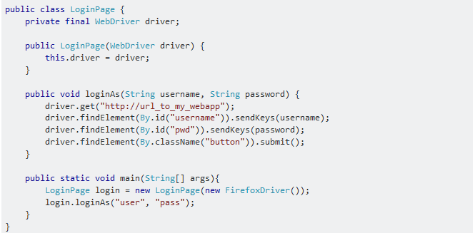
Selenium WebDriver API

Slide 12
Page Object Pattern
Wrap page related locators and actions in an object
Maintainability of tests
DRY principle

Slide 13
Selenium Excercice
Try to understand setup
Find other use cases
Write Cucumber/Specflow scenario
Automate with Selenium
Java Bitbucket URL https://bitbucket.org/demolge/axxes-traineeship-testing-java
C# Bitbucket URL https://bitbucket.org/demolge/axxes-traineeship-testing-dotnet

Slide 14
We’ve only scratched the surface
Functional testing vs non-functional testing
Performance testing
Usability testing
Mobile testing with appium
Spock/Geb/Selenium Combo

Slide 15
Veel succes!
Lots of success!
Beaucoup de succes!
Viel Erfolg!
Mucho éxito!

